Slide 1
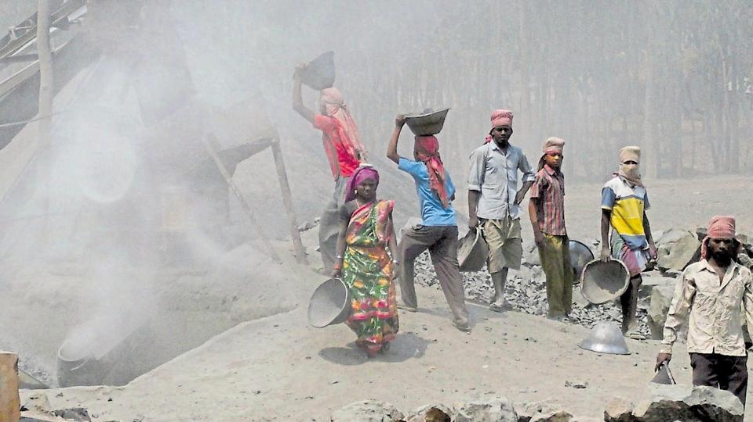
Prevention of dust-inhalation among stone-cutter workers
Team Members-
Shubham Mittal
Sanaz Agarwal
Bhumika Ghosh
Faculty Facilitators-
Dr. Debabrata Dasgupta
Dr. Bahni Ray

Slide 2
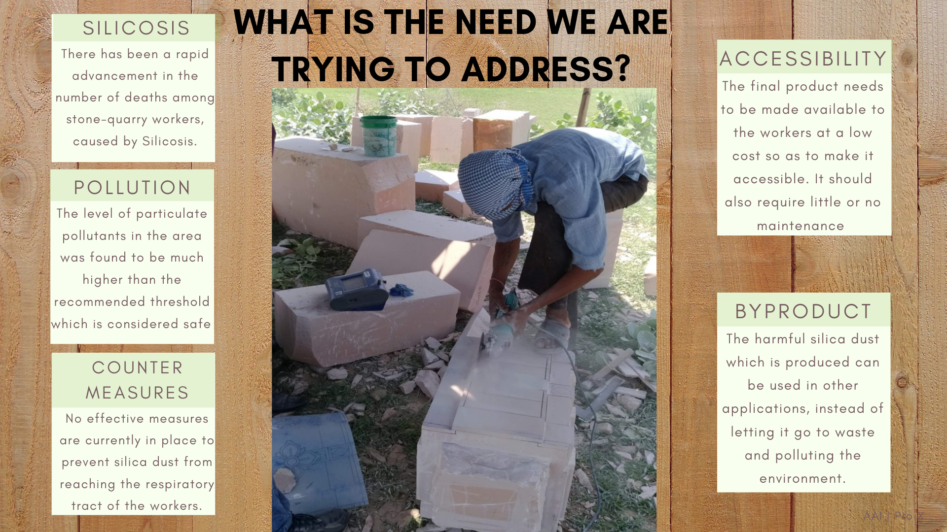

Slide 3

INNOVATION COMPONENTS OF THE PRODUCT

Slide 4
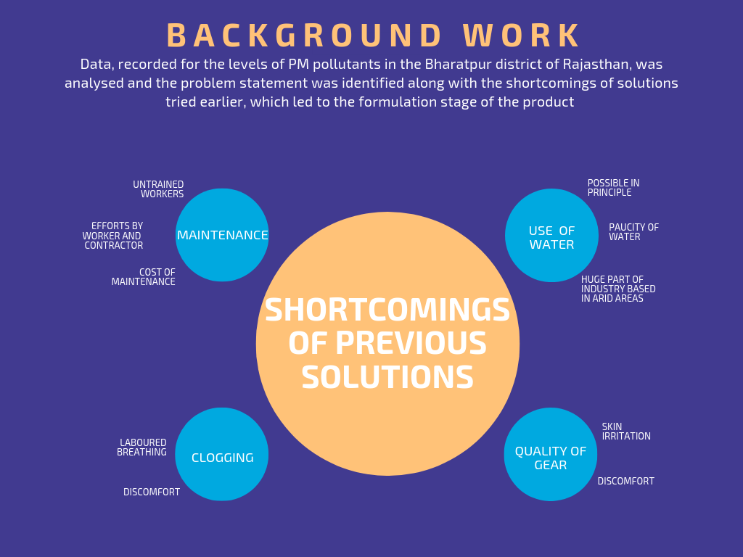
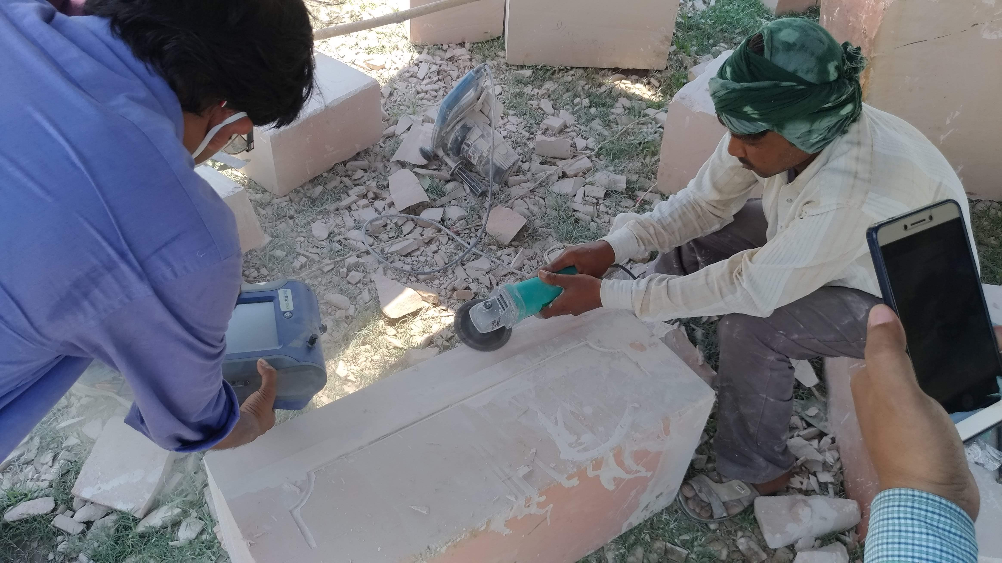
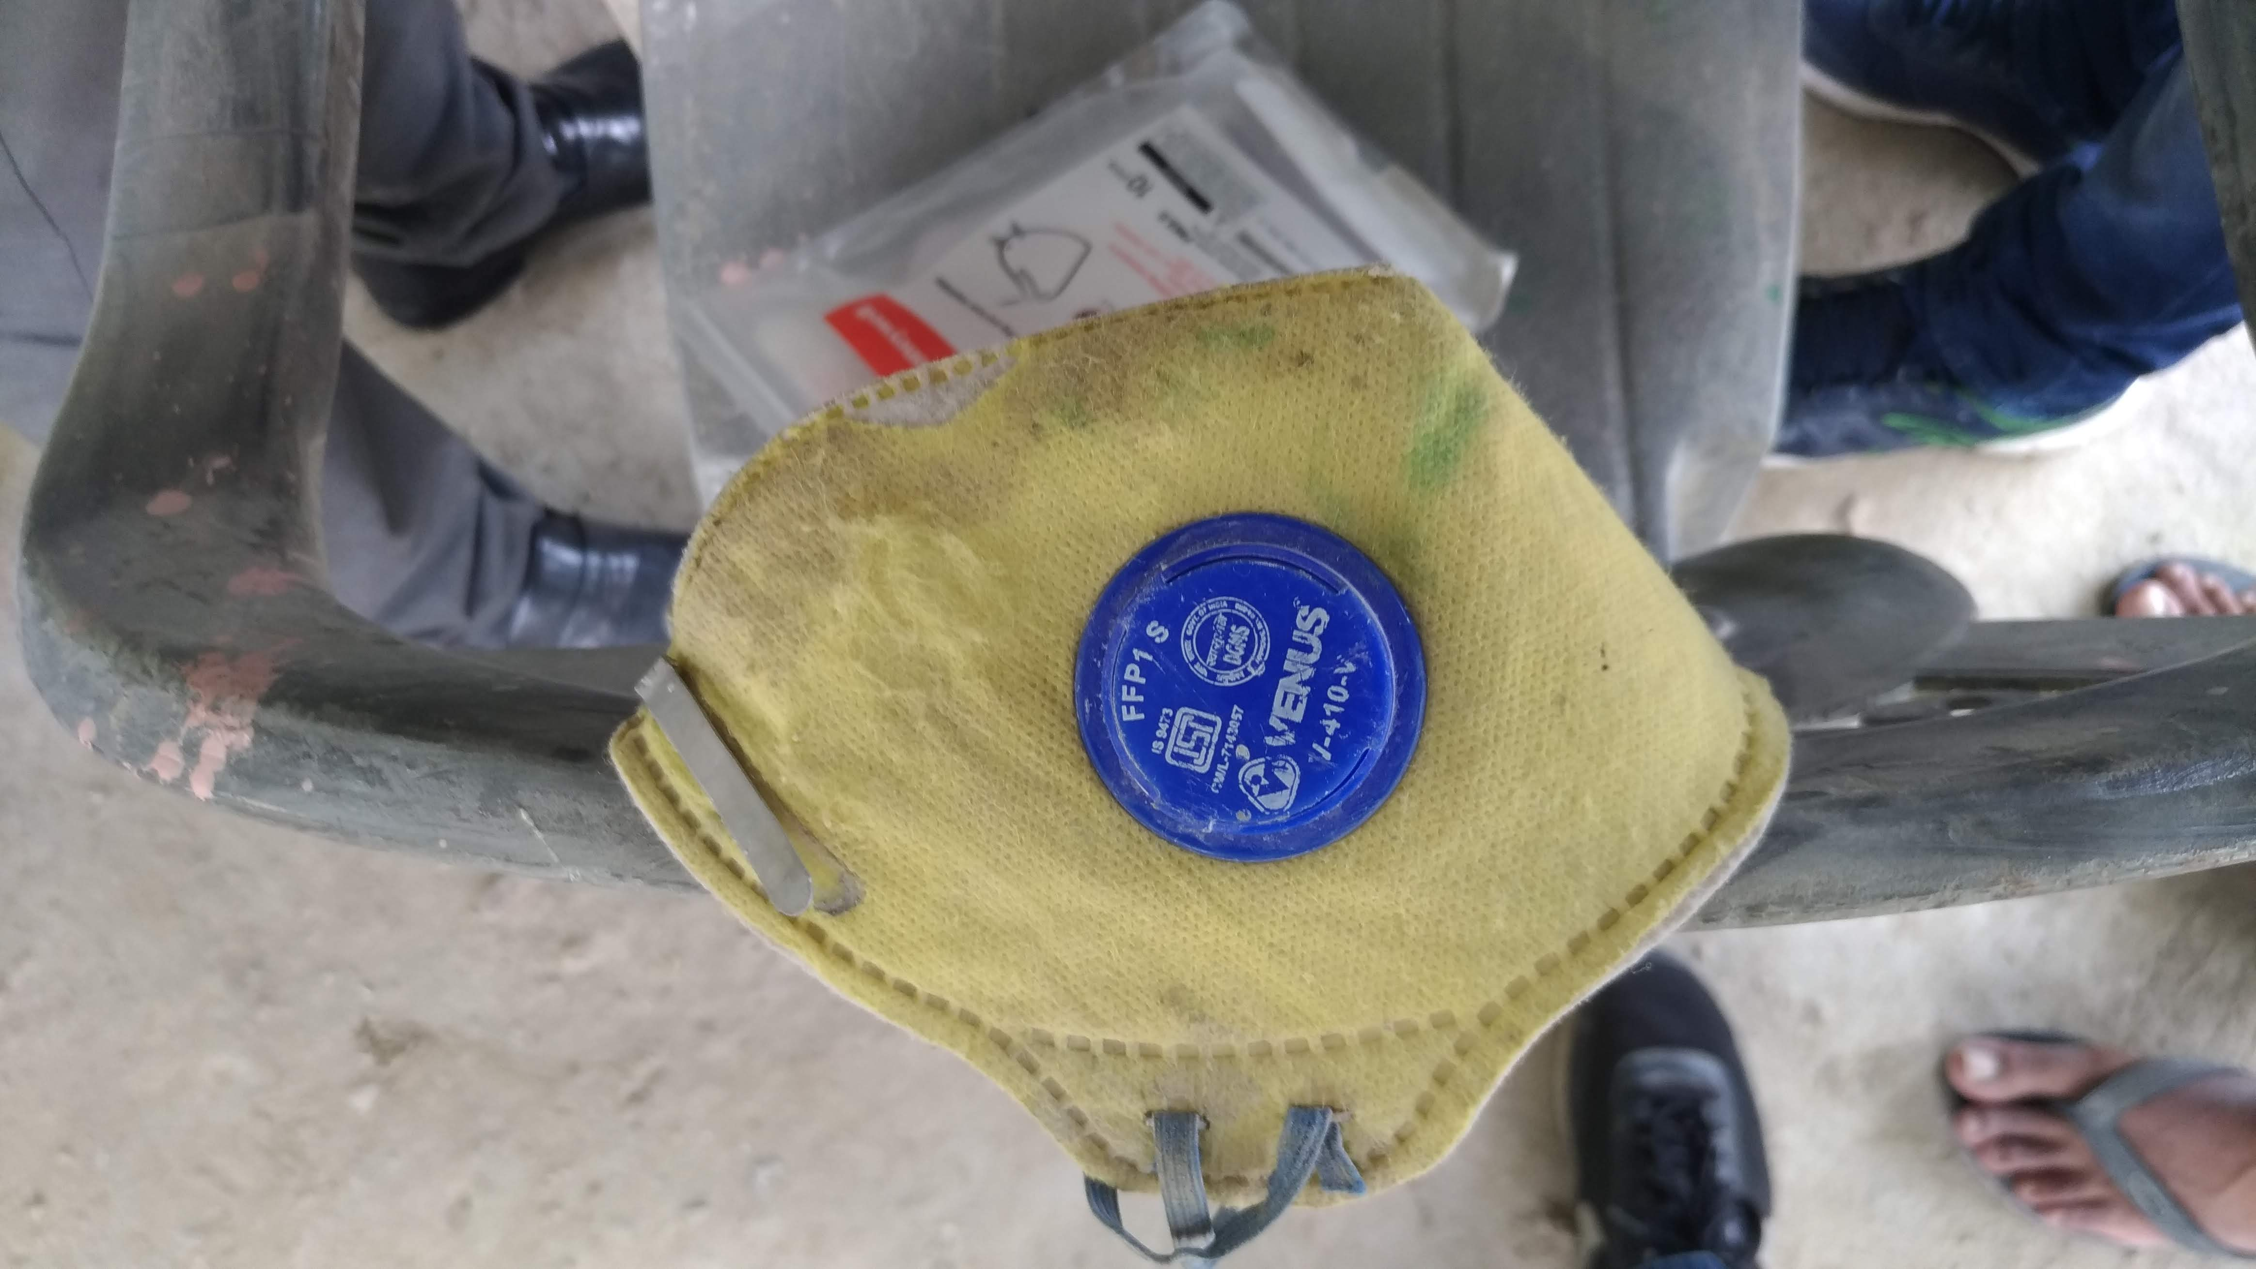

Slide 5


